Slide 1
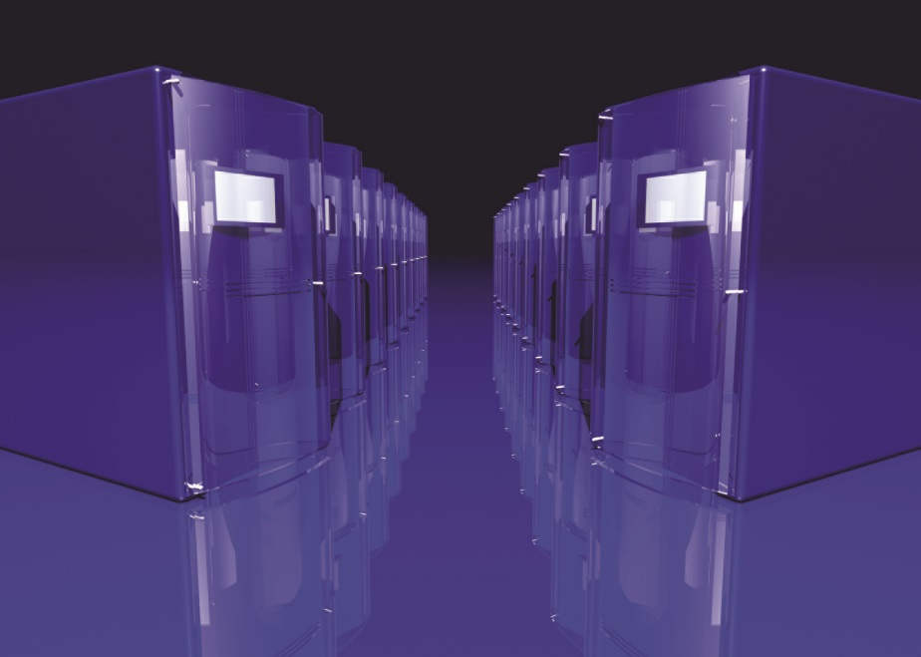
IT Essentials (CompTIA A+) Ch. 18
Virtualization

Slide 2
Overview
In this chapter, you will learn how to:
Explain why virtualization is so highly adopted
Create and use a virtual machine
Describe the service layers and architectures that make up cloud computing
Notes:
2

Slide 3
Introduction
Virtualization creates a complete environment for a guest operating system to function as if it were installed on its own computer.
A single computer running specialized software is called the host.
The guest environment is called the virtual machine (VM).
Uses for virtualization that incorporate the Internet are called cloud computing.

Slide 4
Benefits of Virtualization
Power saving
Hardware consolidation
System management and security
Research

Slide 5
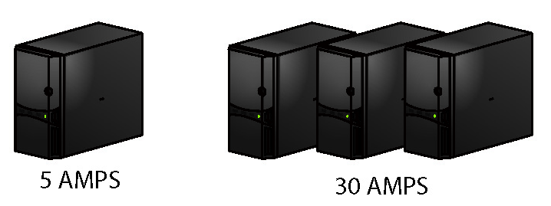
Power Saving
Place multiple virtual servers or clients on a single physical system.
Substantially reduces electrical power use
Figure 18.1 Virtualization saves power

Slide 6
Hardware Consolidation
Avoid purchasing expensive hardware that is rarely used.
Complex desktop PCs can be replaced with thin clients.
Simple and durable
Only need enough power to access the server
Can replace complete desktop PCs
A single physical server machine can run several servers or clients.

Slide 7
System Management and Security
Simpler systems are easier to manage.
Virtual machines can be copied like other files.
If a system goes down due to hacking or malware:
Can shut down the VM and restore a clean copy of it, rather than restore a physical system
VMs should still get the same security treatment as a physical system.

Slide 8
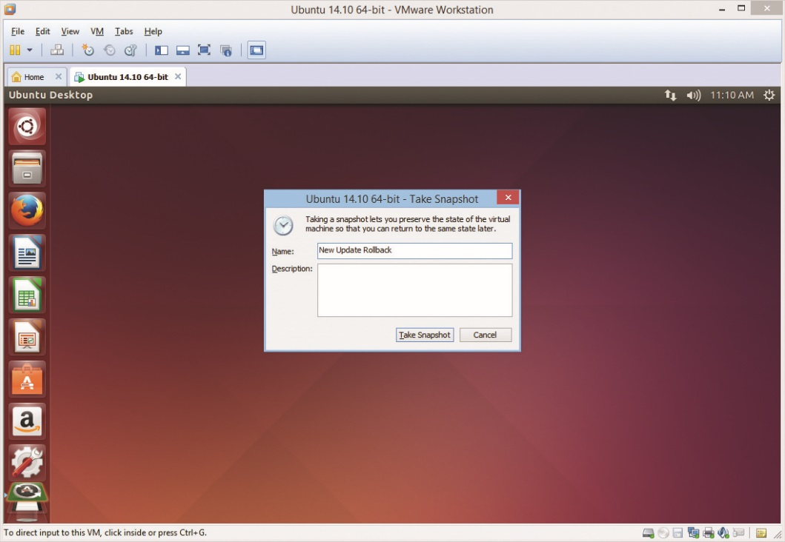
System Management and Security
Saving a snapshot
Saves the virtual machine’s state at the moment
Allows quick return to this state later
Not a long term backup strategy
Figure 18.2 Saving a snapshot
Notes:
Virtualized operating systems use the same security features as real operating systems. For each virtual machine user account, you’ll need to keep track of user names, passwords, permissions, and so on, just like on a normal PC.

Slide 9
Research
Supporting software
Virtualization eliminates the need to keep several machines on hand with various OSs for:
Software testing
Support
Or similar purposes
Today, a single virtualization host allows many OSs on one machine.

Slide 10
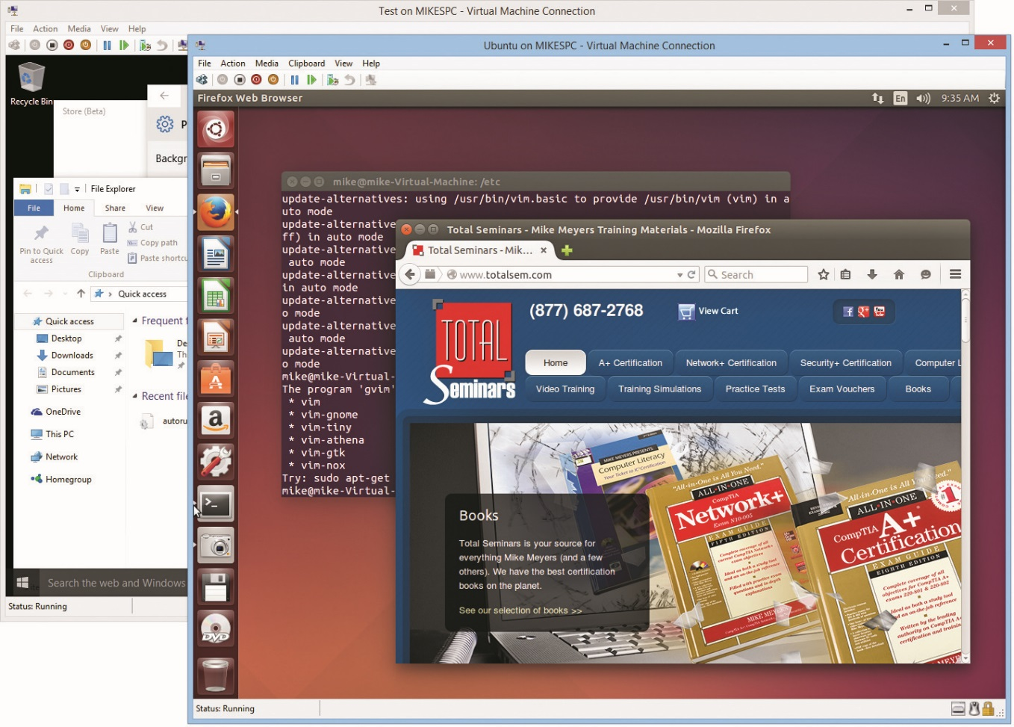
Implementing Virtualization
Figure 18.3 Hyper-V running Linux and Windows 10

Slide 11
Meet the Hypervisor
A normal OS uses a program called a supervisor.
Handles very low-level interaction among hardware and software (i.e., task scheduling, allotment of time and resources, etc.)
Full virtualization requires an extra layer of programming called the hypervisor.
Manages the complex interactions between the host and guest machines

Slide 12
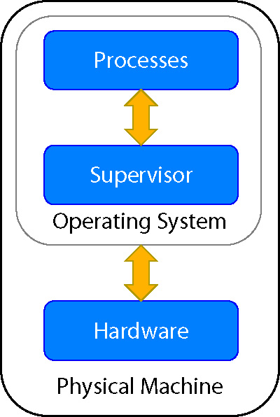
Meet the Hypervisor
Figure 18.4 Supervisor on a generic single system

Slide 13
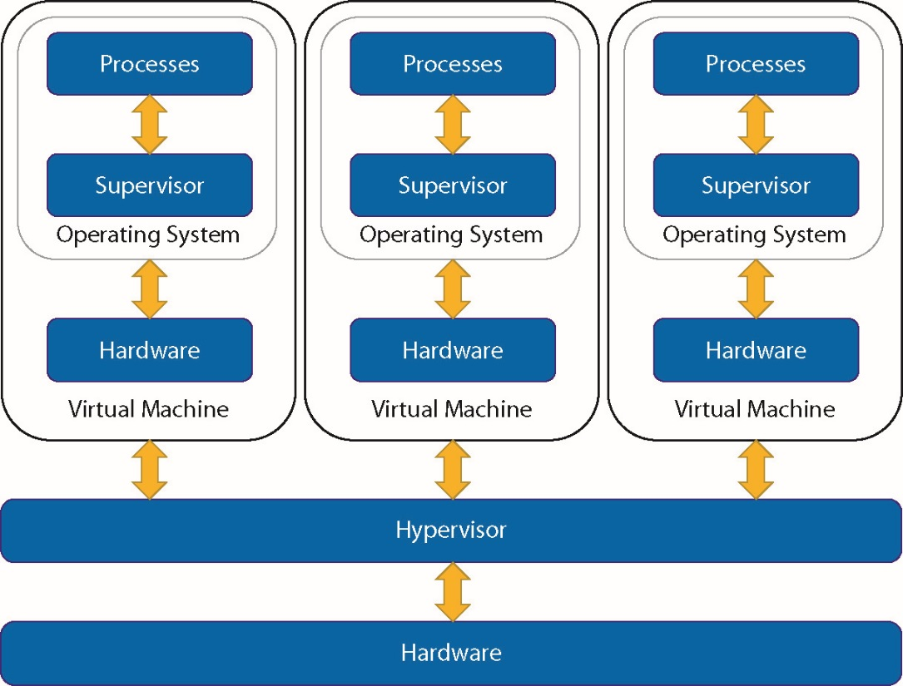
Meet the Hypervisor
Figure 18.5 Hypervisor on a generic single system hosting three virtual machines

Slide 14
Meet the Hypervisor
Hypervisors
VMware (oldest)
VMware workstation was released in 1999 for Linux and Windows.
VMware offers a broad cross-section of virtualization products.
Hyper-V (Microsoft)
Comes with Windows Server as well as desktop Windows starting with Windows 8.1 Pro
Oracle VM VirtualBox
Runs on Windows, Mac OS, and Linux
VMWare Fusion or Parallels Desktop for Mac OS X
Notes:
VMware makes a number of amazing virtualization products, but they can be pricey. Microsoft’s Hyper-V, Linux’s KVM, and Oracle’s VirtualBox are all free.

Slide 15
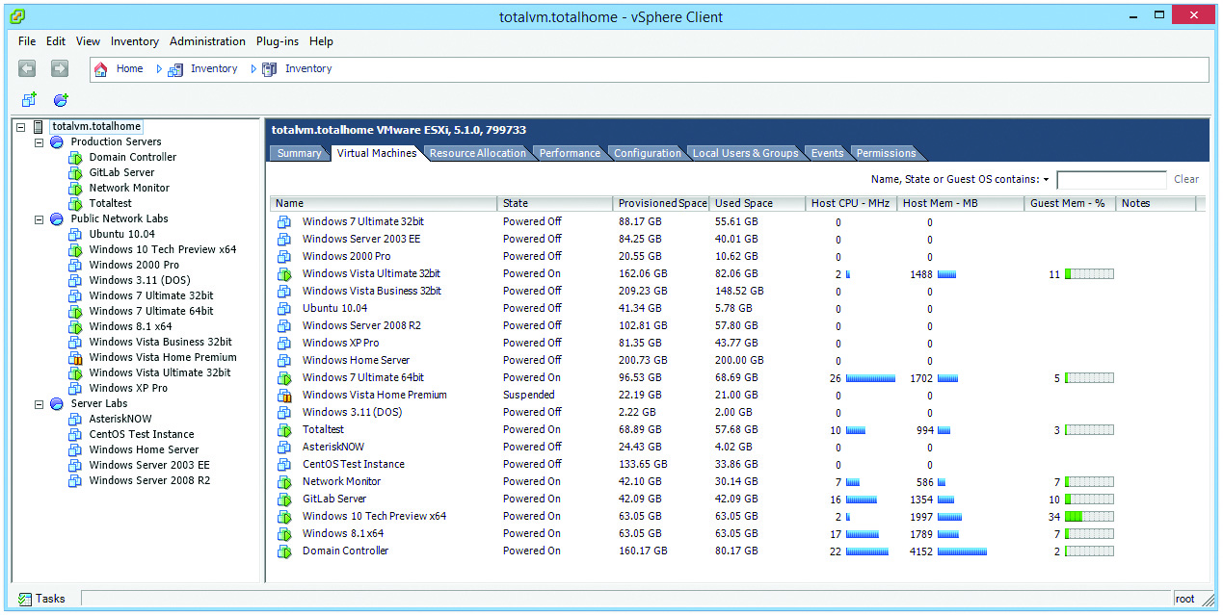
Meet the Hypervisor
Figure 18.6 Author’s busy VMware server

Slide 16
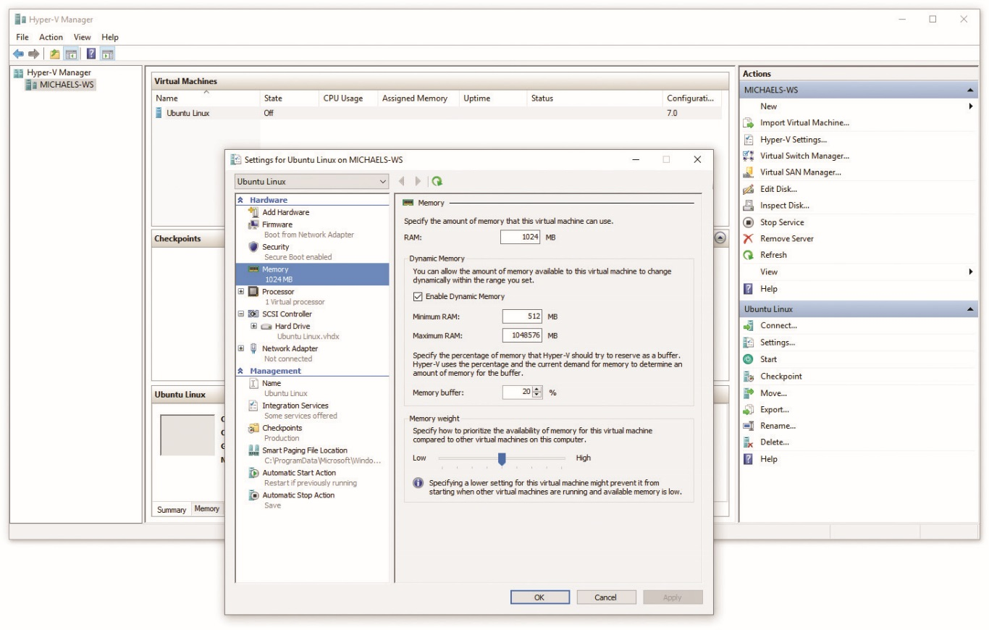
Meet the Hypervisor
Figure 18.7 Hyper-V on a Windows 10 system

Slide 17
Emulation Versus Virtualization
Virtualization uses hardware from the host system and allocates it between individual virtual machines.
The hypervisor passes the code from the virtual machine to the CPU.
It cannot virtualize hardware that is on a different platform (an Intel platform cannot virtualize a Nintendo 3DS).
Emulation enables software written for a different platform to run.
It does not virtualize the hardware.

Slide 18
Emulation Versus Virtualization
An emulator is software or hardware that converts the commands to and from the host machine into an entirely different platform.
For example, an emulator makes it possible to run game console software on a PC.
Notes:
While the CompTIA A+ 220-902 exam objectives include emulator requirements as a part of virtualization, the concepts are not the same. For the sake of completeness, however, know that emulating another platform (using a PC to run Sony PlayStation 4 games, for example) requires hardware several times more powerful than the platform being emulated.

Slide 19
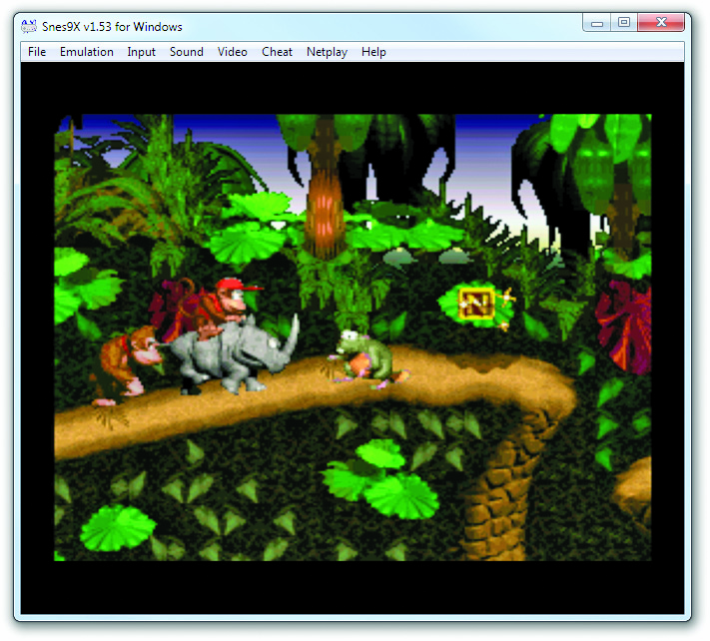
Emulation Versus Virtualization
Figure 18.10 Super Nintendo emulator running on Windows
Notes:
Figure 18.10 shows a Super Nintendo Entertainment System emulator, Snes9X, running a game called Donkey Kong Country on a Windows system.

Slide 20
Client-Side Virtualization
Simple form of virtualization
Running virtual machine on a local system
Does not matter whether VM file itself stored locally or centrally
Creating a virtual machine involves:
Setting up hardware
Installing a hypervisor
Creating a new virtual machine
Installing the new guest OS on the virtual machine

Slide 21
Hardware Support
Hardware virtualization support
Intel’s VT-x and AMD’s AMD-V added extra features to CPU to support hypervisors
Turn virtualization on or off inside the system setup utility
RAM
Each virtual machine needs as much RAM as a physical one.
Leave enough RAM for hypervisor to run.
Add enough RAM so that every VM you run at the same time will run adequately.

Slide 22
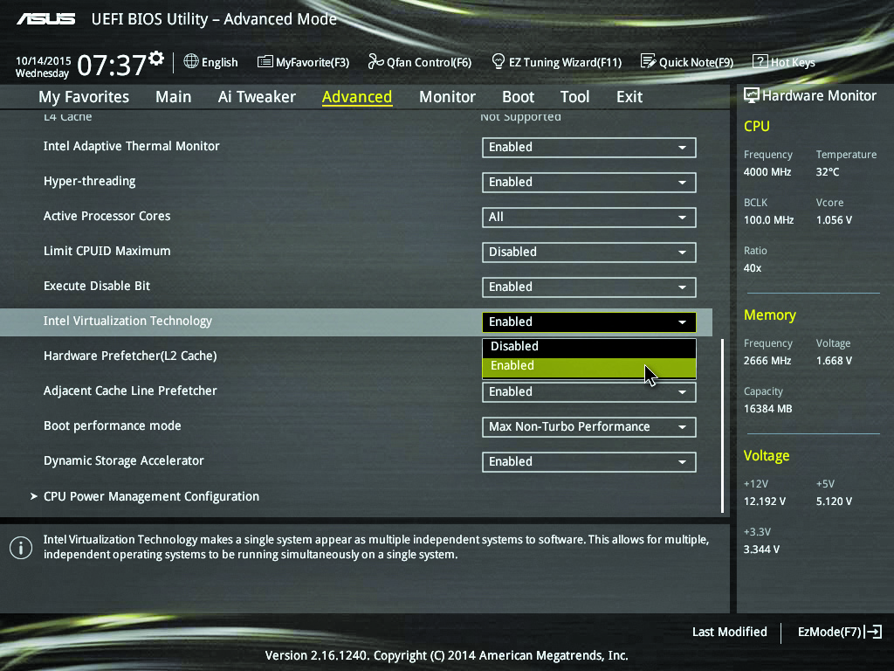
Hardware Support
Figure 18.11 BIOS setting for CPU virtualization support

Slide 23
Hardware Support
Disk space
VM files can be huge (MB to hundreds of GB).
Every snapshot or checkpoint requires space.
Emulator requirements
Hypervisor will emulate a popular, widely supported hardware NIC.
Network support
You can connect each virtual machine to the network in several different ways depending on needs.

Slide 24
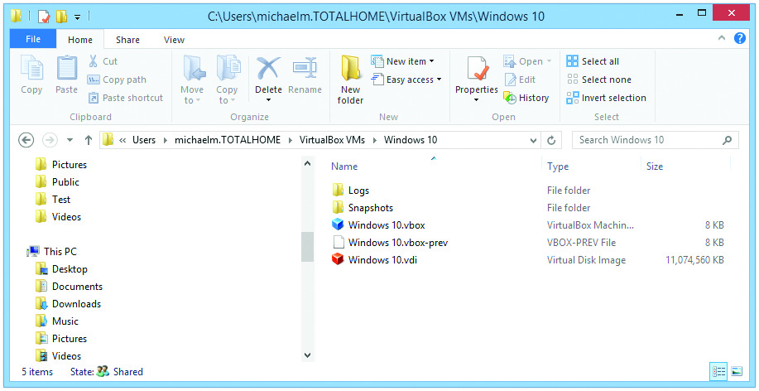
Hardware Support
Figure 18.12 Single VM file taking 11 GB

Slide 25
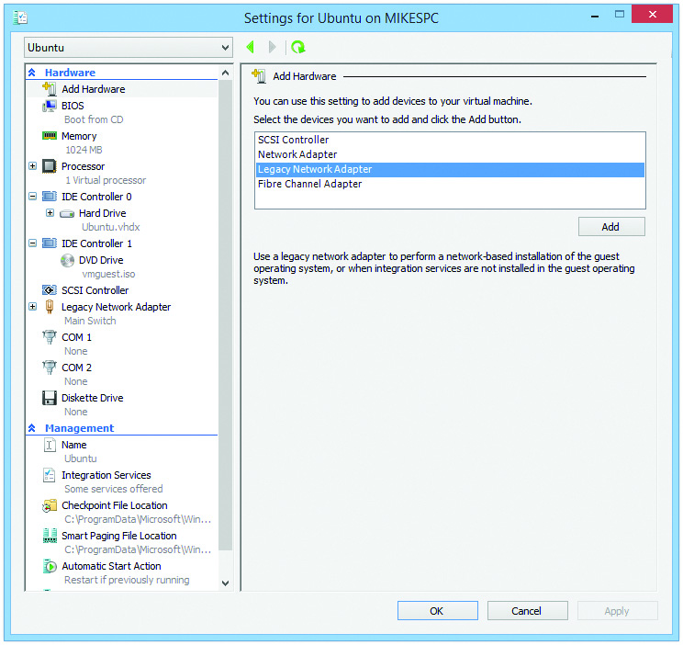
Hardware Support
Figure 18.13 Setting a NIC emulation on Hyper-V

Slide 26
Hardware Support
Internal networking
Every VM acts as if it is connected to own switch and nothing else.
Bridged networking
The VM bridges the real NIC to get out to the network.
Virtual switches
Each hypervisor has its own way to set up virtual switches.
No networking

Slide 27
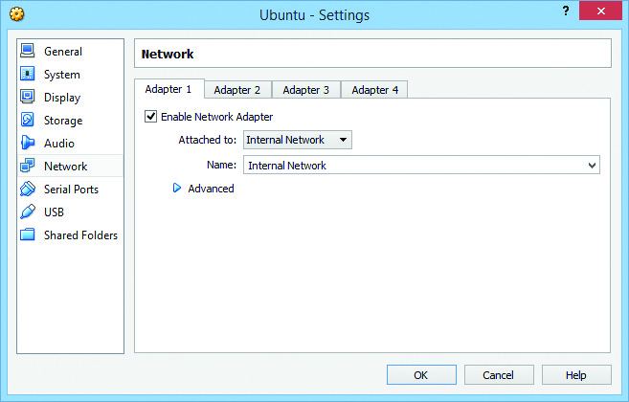
Hardware Support
Figure 18.14 Configuring a VM for an internal network in VirtualBox

Slide 28
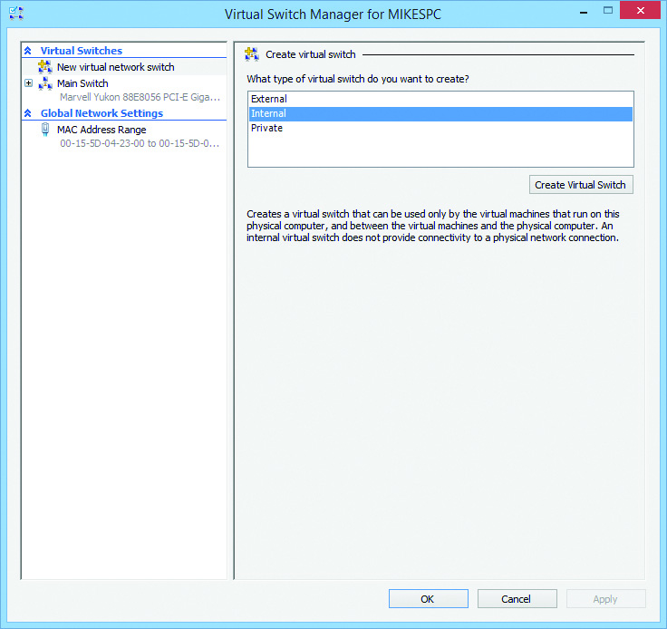
Hardware Support
Figure 18.15 Hyper-V’s Virtual Switch Manager

Slide 29
Installing a Virtual Machine
In a Windows 8/8.1/10 system:
Enable Hyper-V in Programs and Features Control Panel applet.
Select Turn Windows features on or off.
Hypervisor functions as a virtual machine manager.
Primary place to create, start, stop, save, and delete guest virtual machines

Slide 30
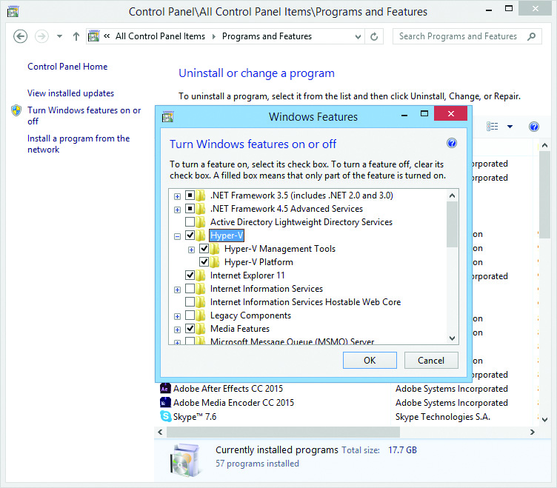
Installing a Virtual Machine
Figure 18.16 Installing Hyper-V in Windows

Slide 31
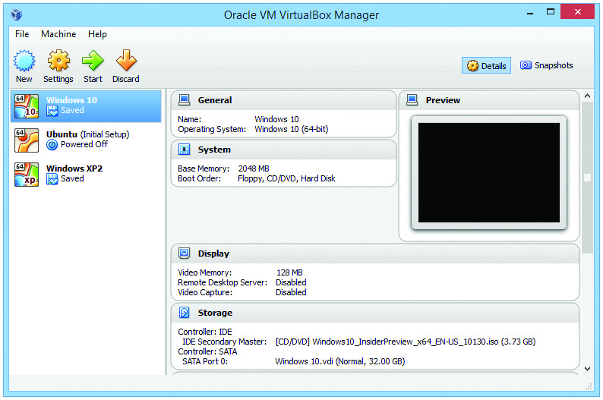
Installing a Virtual Machine
Figure 18.17 Oracle VM VirtualBox Manager (three VMs installed)

Slide 32
Creating a Virtual Machine
Click New | Virtual Machine.
Starts wizard
Presets for several crucial settings
Install the operating system.
Use some form of optical media, a USB flash drive, or an ISO file.
Every virtual machine requires a separate, legal copy of Windows, or any licensed software.

Slide 33
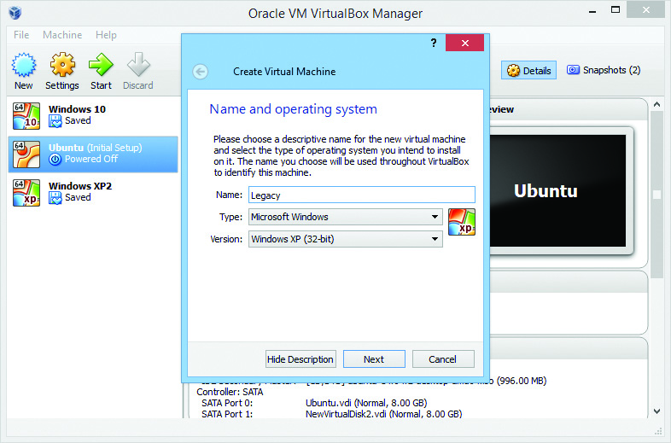
Creating a Virtual Machine
Figure 18.18 Creating a new VM in Oracle VirtualBox

Slide 34
Creating a Virtual Machine
VMware reads installation media and detects the operating system.
VMware selects default settings for RAM, virtual hard drive size, and other settings.
Change settings now or after machine is created.
Give the machine a name.
Determine where you want to store the files.
Virtual desktop is now installed.
Can add or remove virtual hardware

Slide 35
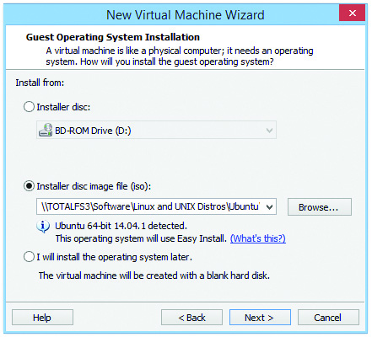
Creating a Virtual Machine
Figure 18.19 Selecting the installation media

Slide 36
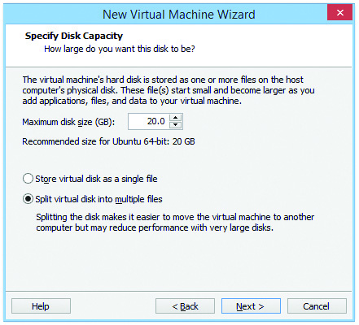
Creating a Virtual Machine
Figure 18.20 Setting the virtual drive size

Slide 37
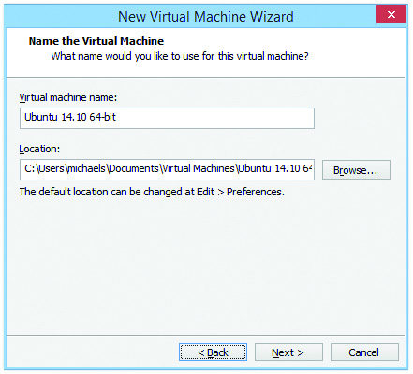
Creating a Virtual Machine
Figure 18.21 Entering VM name and location

Slide 38
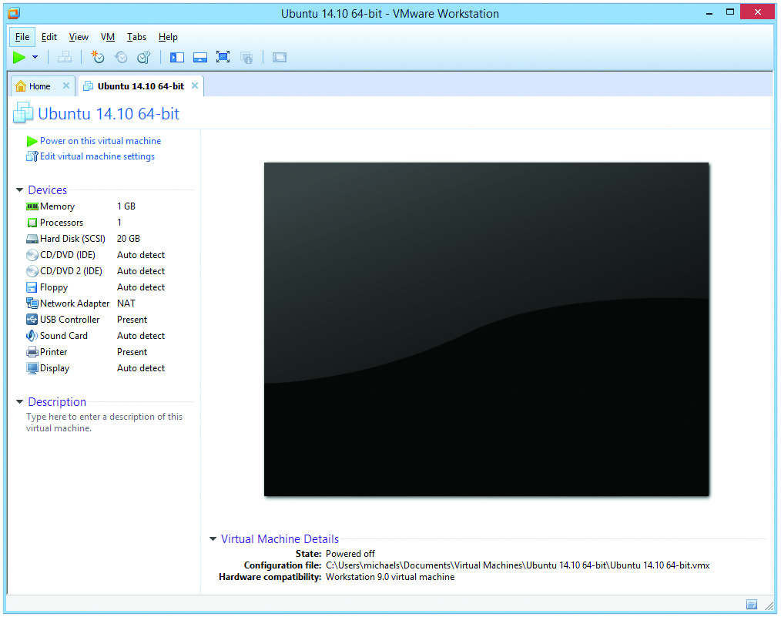
Creating a Virtual Machine
Figure 18.22 VMware Workstation with a single VM

Slide 39
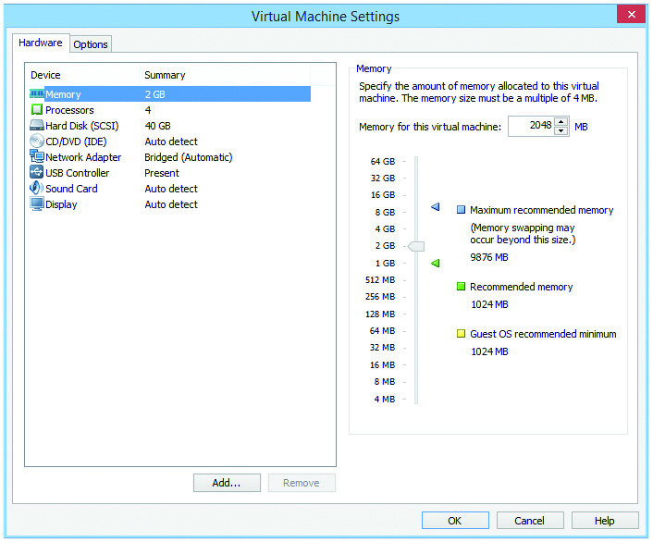
Creating a Virtual Machine
Figure 18.23 Configuring virtual hardware in VMware Workstation

Slide 40
Server-Side Virtualization
Many of the servers we access today are virtualized.
A bare-metal hypervisor:
Installed without a host operating system
No other software between it and the hardware (just bare metal)
Industry refers to:
Bare-metal hypervisors as Type-1
Applications such as VMware Workstation as Type-2

Slide 41
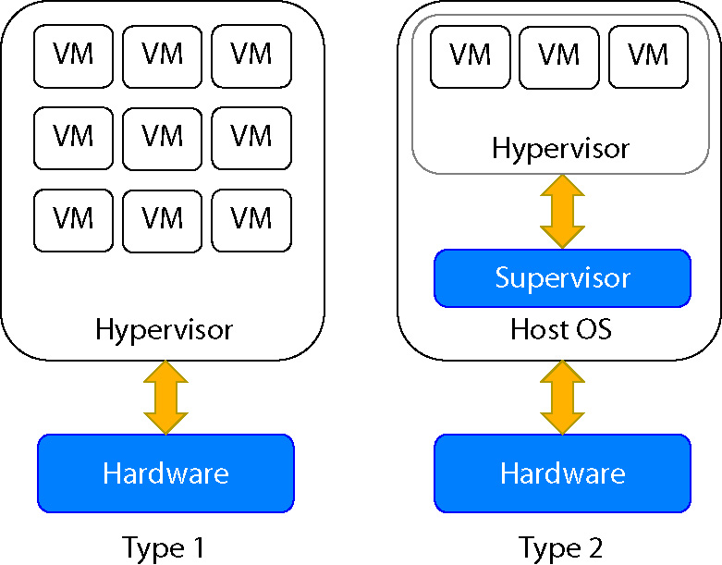
Server-Side Virtualization
Figure 18.24 Type-1 vs.Type-2 hypervisors

Slide 42
Server-Side Virtualization
ESXi is a free Type-1 hypervisor from VMware.
Management handled through a Web interface
Small in size; only job is to host virtual machines
VMs need different amounts of resources.
Can distribute across available hosts to minimize unused resources

Slide 43
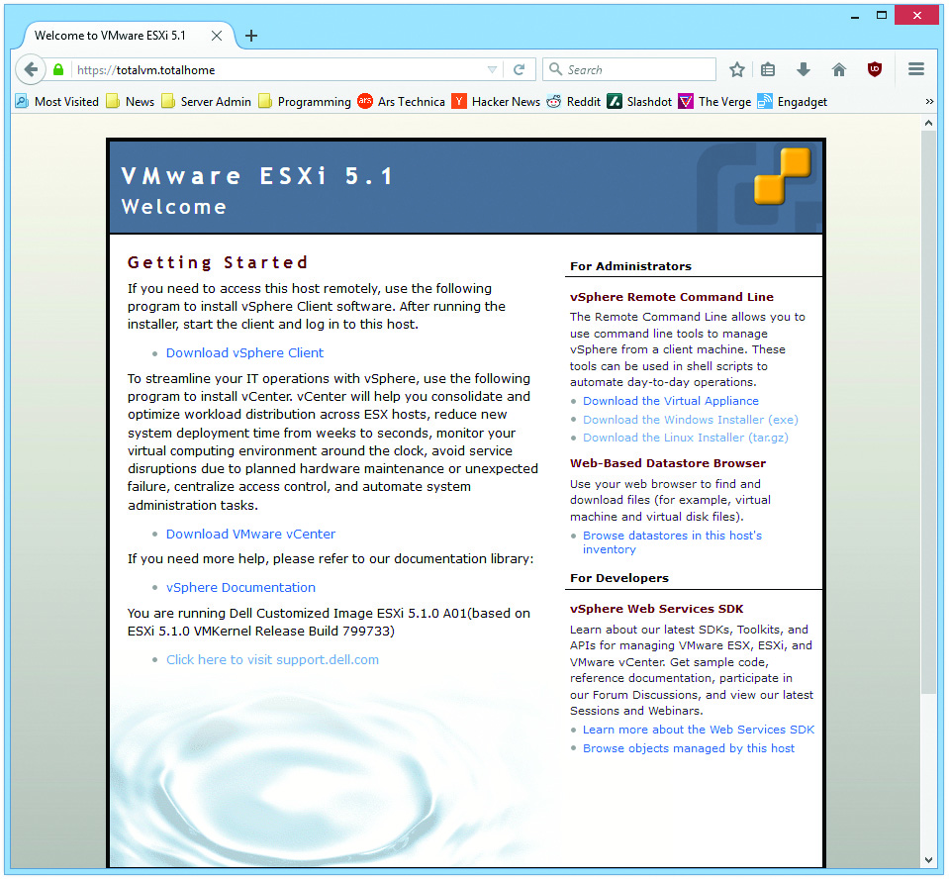
Server-Side Virtualization
Figure 18.25 Web interface for ESXi

Slide 44
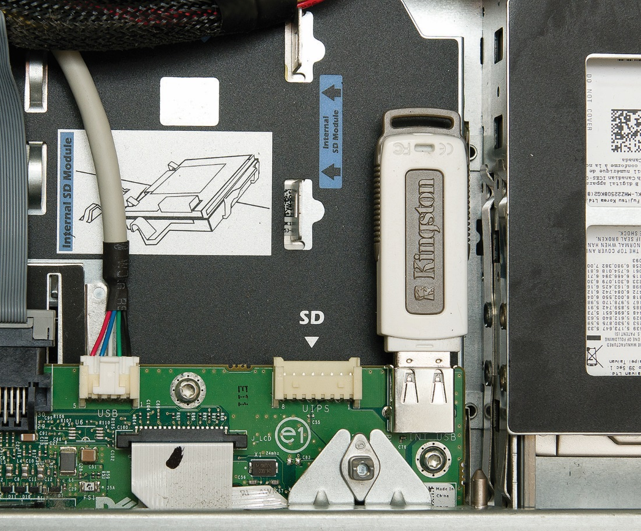
Server-Side Virtualization
Figure 18.26 USB drive on server system

Slide 45
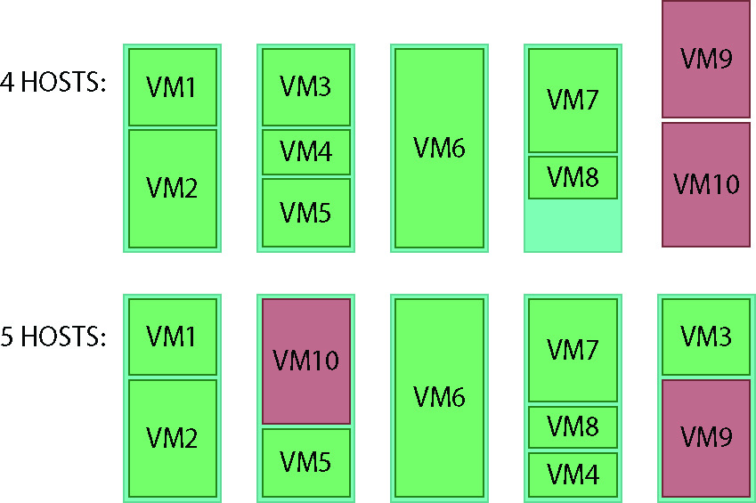
Server-Side Virtualization
Figure 18.27 No vacancy on these hosts

Slide 46
To the Cloud
The cloud involves networks of servers worldwide.
It began around 2005 when Amazon started offering a new kind of hosting service.
Large groups of virtualized servers utilized
Customers click and start a desired server
Popular cloud uses include:
Data storage
On-demand computing resources

Slide 47
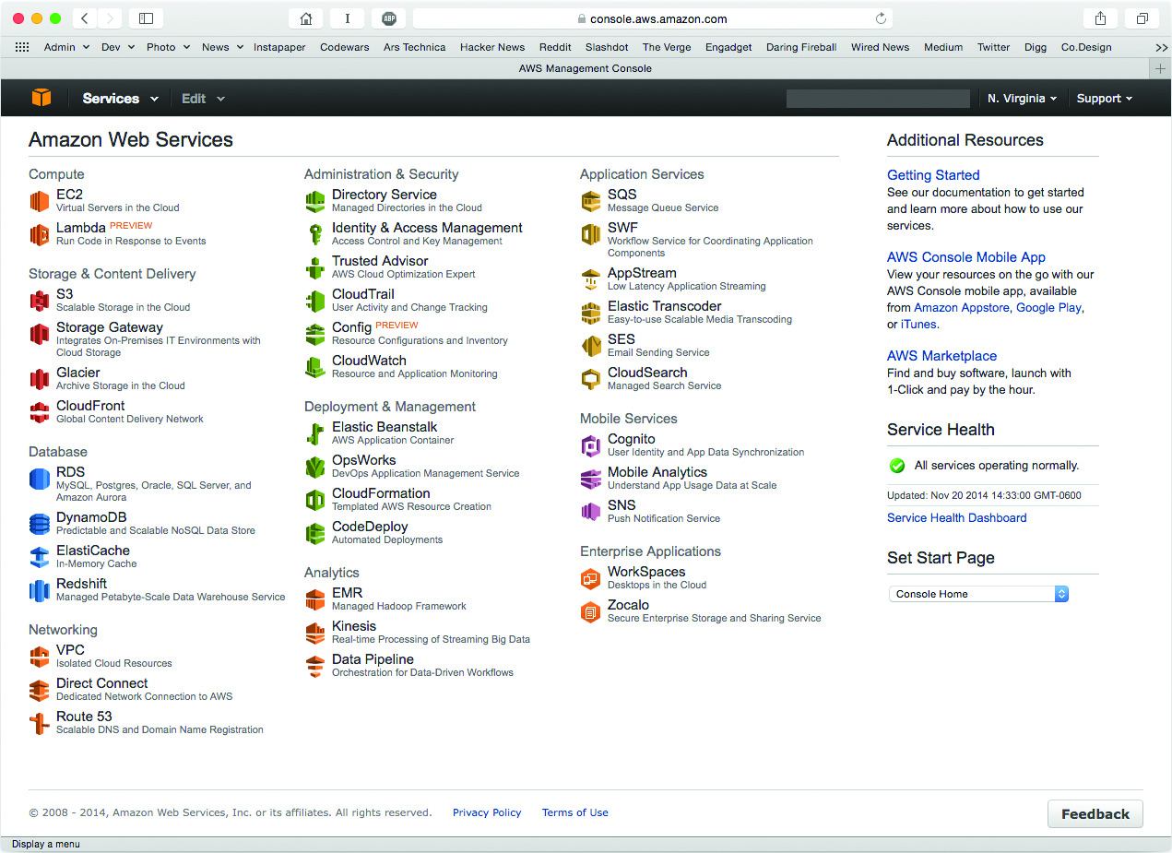
To the Cloud
Figure 18.28 Amazon Web Services Management Console

Slide 48
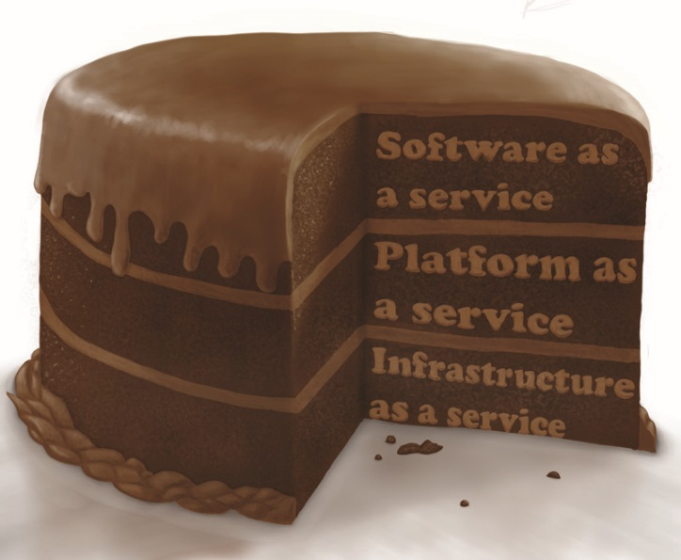
The Service-Layer Cake
We use the servers and networks of the cloud through layers of software.
Simplifies performing complex tasks or managing powerful hardware
Figure 18.29 A tasty three-layer cake

Slide 49
The Service-Layer Cake
Infrastructure as a Service (IaaS)
Uses virtualization to minimize hardware, and protect against data loss and downtime
Purchasing expensive, heavy hardware no longer needed
Billed based on usage
Still responsible for configuring and maintaining the OS and software

Slide 50
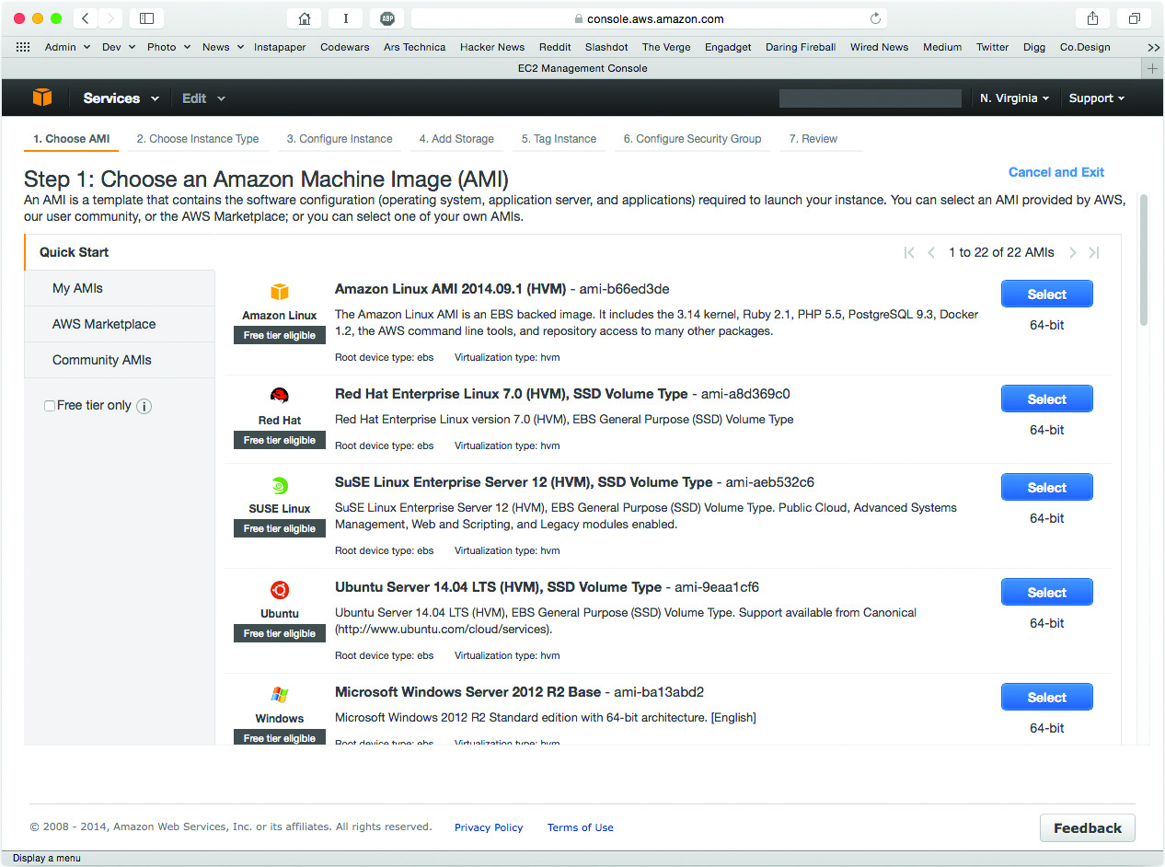
The Service-Layer Cake
Figure 18.30 Creating an instance on AWS

Slide 51
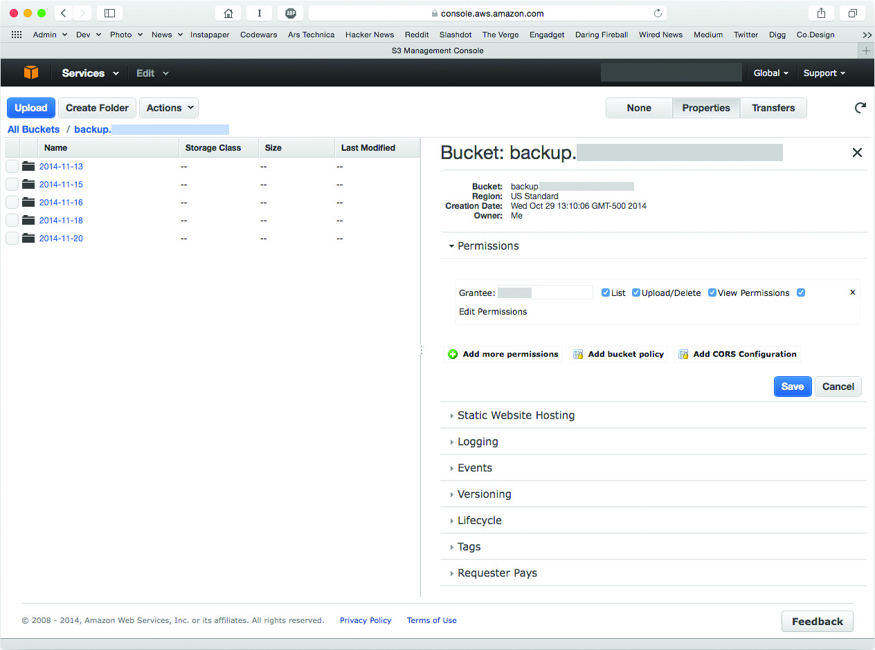
The Service-Layer Cake
Figure 18.31 Amazon Simple Storage Service (S3)

Slide 52
The Service-Layer Cake
Platform as a Service (PaaS)
PaaS gives programmers all the tools to deploy, administer, and maintain a Web application.
PaaS provider builds a platform on top of infrastructure.
Infrastructure is largely invisible to the developer.
Software as a Service (SaaS)
Web applications
Subscription model
Some apps are free (example: Google Maps)

Slide 53
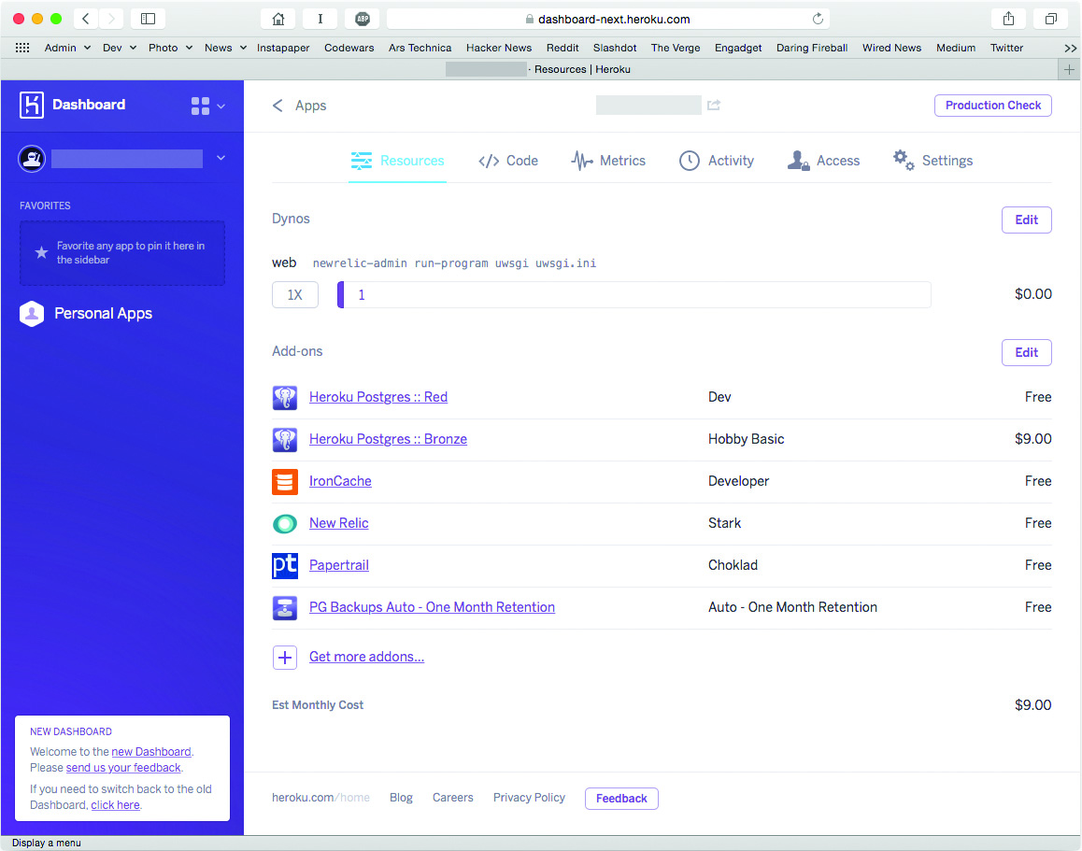
The Service-Layer Cake
Figure 18.32 Heroku’s management console

Slide 54
Software as a Service
There is no need to regularly update software.
Subscription model makes it easier to budget.
One tradeoff with SaaS is that you no longer maintain strict control of your data.
Some companies have concerns over security of their intellectual property.

Slide 55
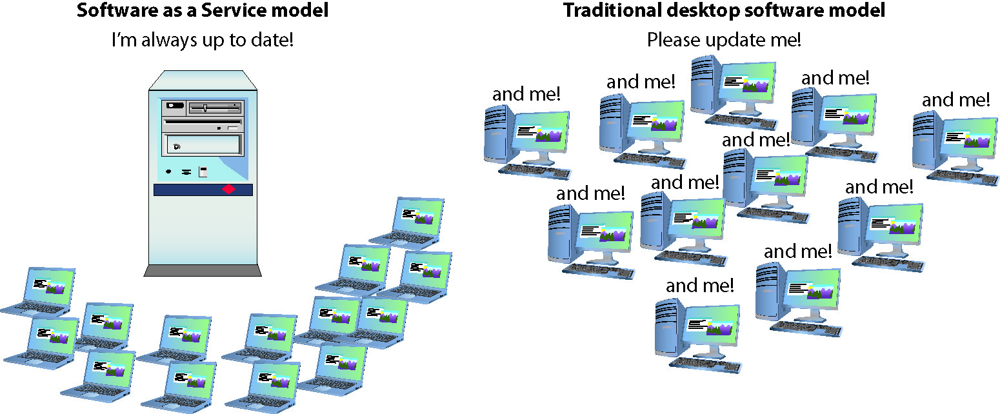
Software as a Service
Figure 18.33 SaaS vs. every desktop for themselves

Slide 56
Ownership and Access
Each organization makes its own decisions concerning tradeoffs.
Cost, control, customization, and privacy
Types of cloud networks include:
Public
Private
Community
Hybrid

Slide 57
Public Cloud
Software, platforms, and infrastructure delivered through networks the general public can use
Hardware owned by companies like Amazon, Google, and Microsoft
Public cloud concepts
Public IaaS
Public PaaS
Public SaaS

Slide 58
Private Cloud
Internal cloud that the business actually owns
Company with resources could build and operate
Or contact a third party to maintain and host it
Private cloud concepts
Private IaaS
Private PaaS
Private SaaS

Slide 59
Community Cloud
Private cloud paid for and used by more than one organization
Group of organizations with similar goals or needs
Community cloud concepts
Community IaaS
Community PaaS
Community SaaS

Slide 60
Hybrid Cloud
Some combination of public, private, and community clouds
Allowing communication between them
Letting one application span two types of cloud
Integrating services across cloud types
Hybrid cloud concepts
Hybrid IaaS
Hybrid PaaS
Hybrid SaaS

Slide 61
Why We Cloud
Virtualization
Rapid elasticity
Easily expand number of servers with just a click
On-demand
Application adjusts to meet the current demands
Resource pooling
Measured service
Charged based on traffic going in and out of Web application or based on time servers running

Slide 62


Slide 63
Summary
Explain why virtualization is so highly adopted
Create and use a virtual machine
Describe the service layers and architectures that make up cloud computing

Slide 64
